Slide 1
Machine learning for nuclear physics
Young-Ho Song
(RISP, Institute for Basic Science)
온라인세미나, 2020.12.09. (연세대학교)
https://yonsei.zoom.us/j/93629802196

Slide 2
Disclaimer
Note that I am not an expert on Machine Learning, but a nuclear physicist who is interested in Machine Learning.
This is just an introduction of basic concepts of Machine Learning , especially, a supervised machine learning called neural network.

Slide 3
Many good resources
References
1. Deep Learning with Python, Francois Chollet
2. Neural Networks and Deep Learning, M. Nielsen
http://neuralnetworksanddeeplearning.com/
3. Machine Learning for Physicists, Florian Marquardt
https://machine-learning-for-physicists.org/
4. Machine Learning Crash Course, Google
https://developers.google.com/machine-learning/crash-course
5. A high bias low-variance introduction to Machine Learning for physicists, P. Mehta et al.
https://doi.org/10.1016/j.physrep.2019.03.001
And much more

Slide 4
Outline
Introduction
Basics of Machine Learning
Basics of Neural Networks
Some topics in ML
Applications of ML to Nuclear Physics

Slide 5
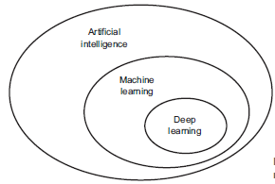
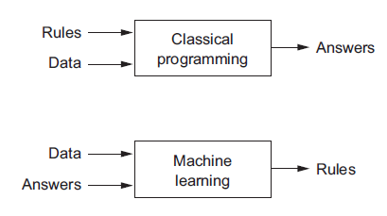
Machine Learning
What does it mean by machine “learning”?
ML is a subfield of artificial intelligence(AI).
The goal of ML is to create an algorithm from data automatically.
→ Pattern Finder
The algorithm created from data will be used to make prediction, making a decision to act.
Figures from Ref.1
Notes:
전통적인 프로그래밍에서는 사람이 룰/알고리즘을 주고 데이터를 입력하면, 결과를 주도록 되어 있다. Machine learning에서는 데이터와 우리가 얻고 싶은 결과를 입력하여 컴퓨터가 최선의 방법을 스스로 찾도록 한다.

Slide 6
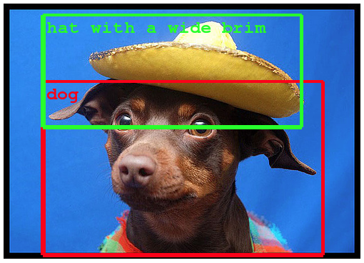
Machine Learning
It is possible to make machine “learn” even when the programmer does not know how to do it exactly.
It can only learns within given model space.
Recent popularity of ML mainly from the success of Deep Neural Networks(very large model space).
Example of Object Detection within Photogaphs Taken from the Google Blog.
Figures from Ref.1
Notes:
전통적인 프로그래밍에서는 사람이 룰/알고리즘을 주고 데이터를 입력하면, 결과를 주도록 되어 있다. Machine learning에서는 데이터와 우리가 얻고 싶은 결과를 입력하여 컴퓨터가 최선의 방법을 스스로 찾도록 한다.

Slide 7
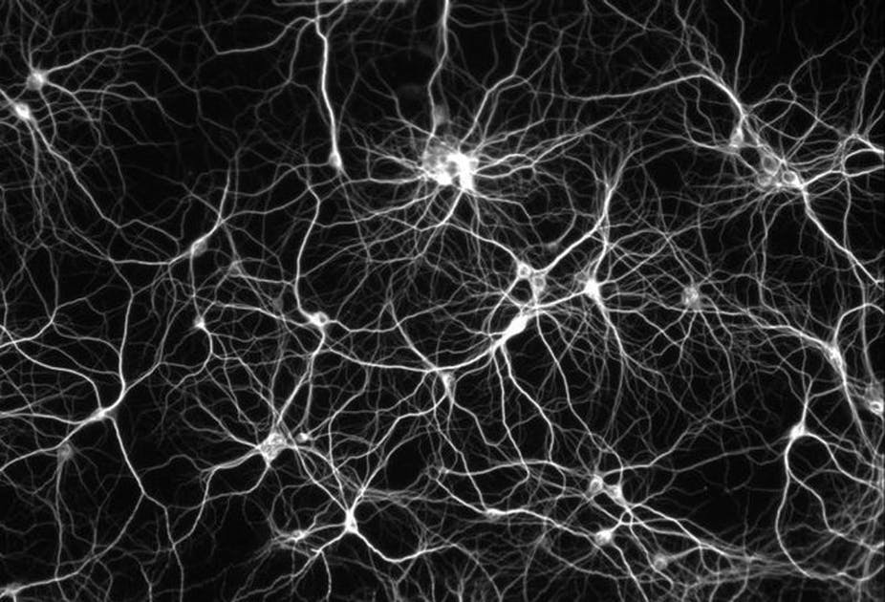


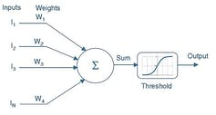
Neural Network and Deep Learning
Artificial Neural Network(ANN)
One of the ML methods inspired from the neuron of brain.
Deep Neural Network(DNN)
Many hidden layers of neurons
Images from Wikipedia

Slide 8
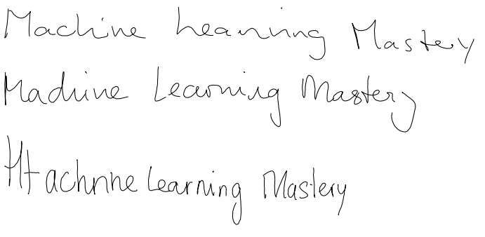
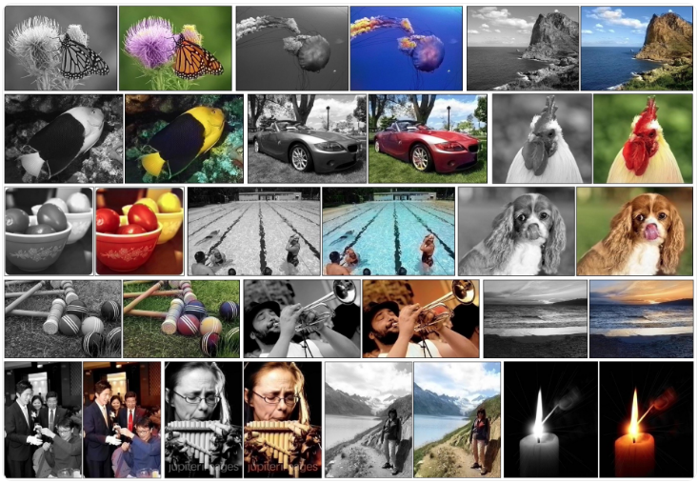
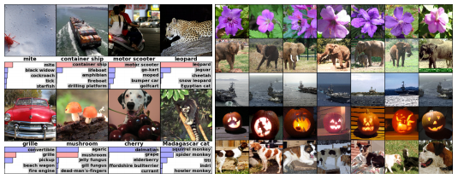
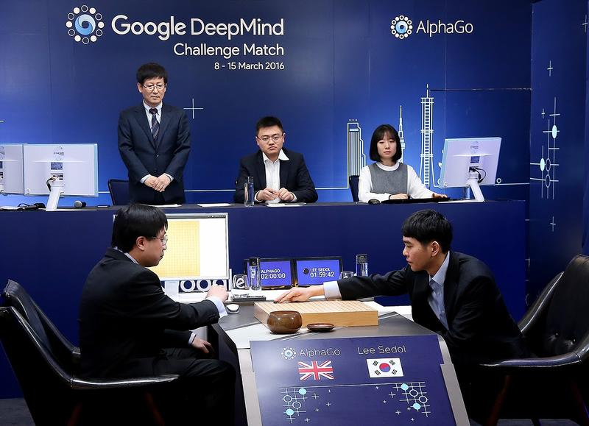
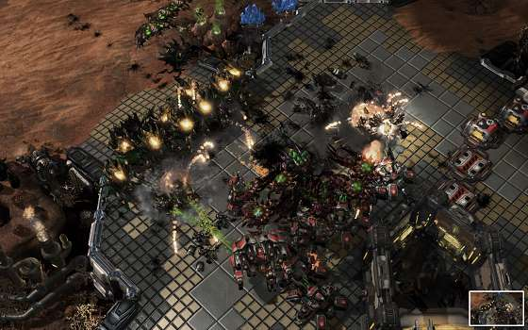
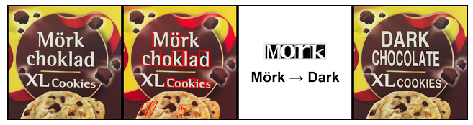
Machine Learning
Examples of Machine Learning(actually deep learning)
Image Recognition
Colorize image
Automatic translation
Automatic hand writing/image generation
Automatic text generation
Game Playing
And so on…
https://machinelearningmastery.com/inspirational-applications-deep-learning/

Slide 9
Application of ML for nuclear physics
A.I. for Nuclear Physics, arXiv:2006.05422v1
More examples
Lattice QCD : reducing sign problem, cheaper/faster generation of new configuration, propagator inversion, extraction of physical observables ….
modelling nuclear masses and other observables, fast emulation for big simulations, identifying crucial experimental data for better constraining theory, uncertainty quantification of theoretical results…
Accelerator and material design optimization, Dynamic optimization of real time operation controls, data classification and regression, triggering …

Slide 10
Three large classes of Machine Learning
Supervised learning
Learn from examples( data = features +labels)
Labels : things we want to predict , answers, y
- Cats and Dogs, mass of nucleus …
Features: input variables, x
- images, (A, Z) …
Examples : labeled examples = set of (features x, labels y)
unlabeled examples = (features, ?)
Models : relationship between features and labels, y = f(x)
Training/Learning : change models gradually to make the model make a better relation between feature and label
Inference : apply the trained model to unlabeled examples. Prediction.

Slide 11
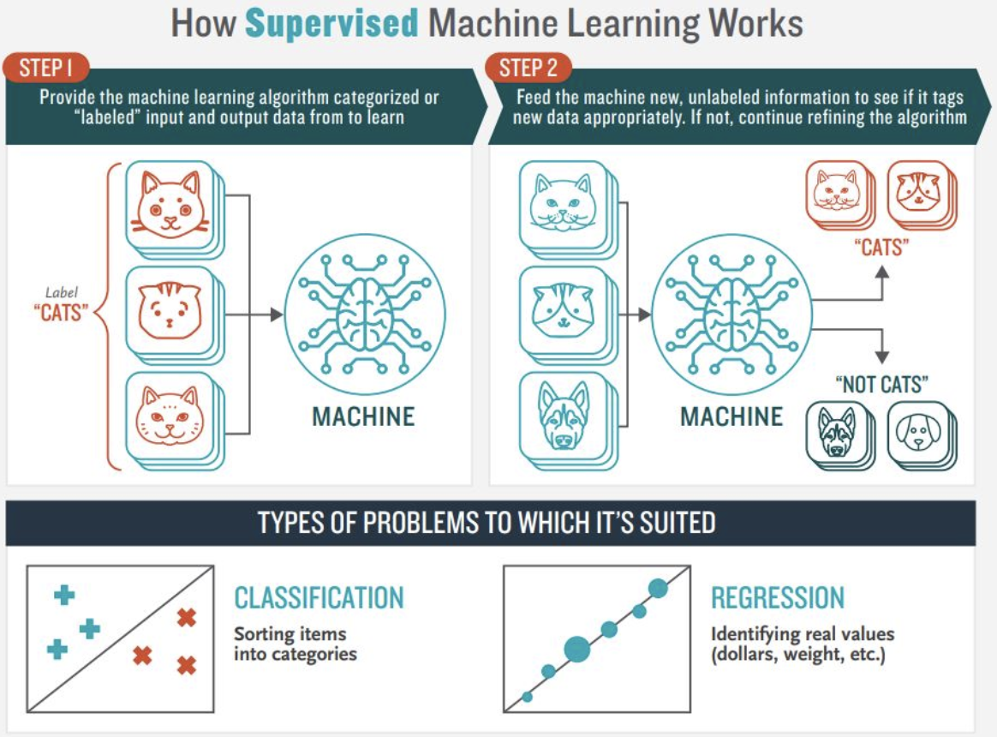
Three large classes of Machine learning
Supervised learning
Classification: Prediction of discrete values
Regression : Prediction of continuous values
Parametric method
y = f(x; p)
Linear Regression, Neural Networks…
Non-parametric method
Parameters are determined by the data y=f(x;p(data))
Lagrange interpolation,SVM, Gaussian Process …
Image from medium.com blog

Slide 12
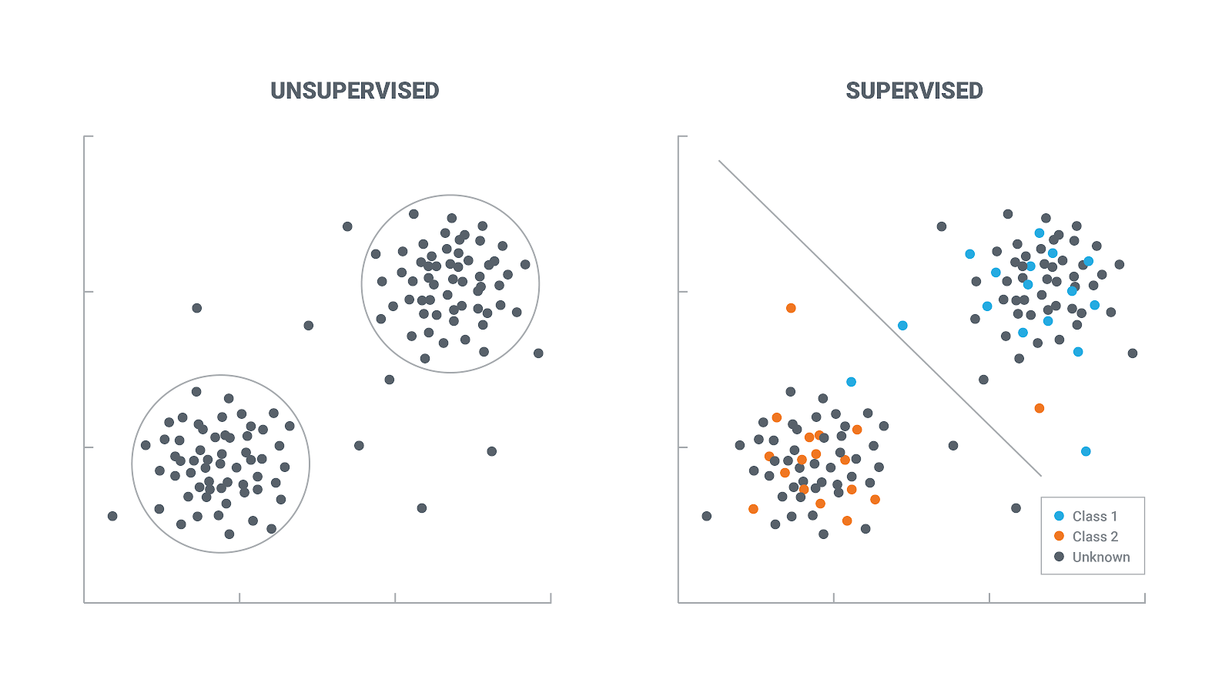

Three large classes of Machine learning
Unsupervised learning
Finding patterns and structure from unlabeled data
Clustering: classify data according to their features
Images classified without telling cats and dogs
Dimensionality Reduction: reduce number of input variables in a dataset
What is important in the inputs ?
Generative Modeling : generate new data
Create a new image of cats and dogs.
Image from https://lawtomated.com
Image from Ref.4

Slide 13

Three large classes of Machine learning
Reinforcement learning
Interact with environment and act to maximize reward
Try to find a best strategy automatically
This Lecture focuses on Supervised Learning( ANN )
Image from Wikipedia

Slide 14
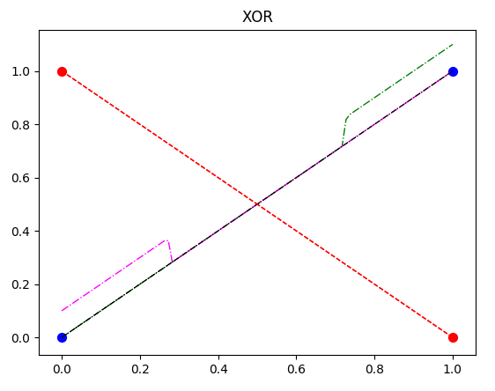
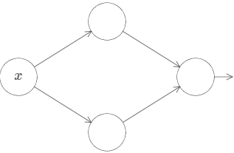
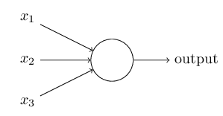
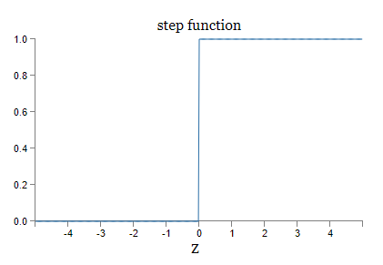
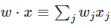
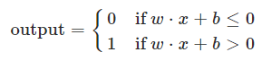
Perceptron/Neuron
Perceptron : weights, bias
- weights (w) and bias (b) are adjusted/trained.
- can be used to compute logical functions
- Example: elementary logical functions
(1) w1=-2, w2=-2, b=3 → NAND function
(2) w1=2, w2=2, b=-1 → OR
(3) problem: construct AND function
(4) problem: Can one make XOR function ?
→ not possible with one perceptron. Why?
→ possible with two perceptron. How?

Slide 15
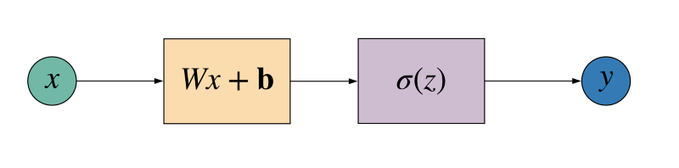

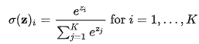
Perceptron/Neuron
Neuron: sigmoid (or other non-linear) activation function
Common activation functions
Identity
Step
Sigmoid
ReLU(rectified linear units)
ELU(Exponentioal linear units)
Tanh
Softmax : classification
More details will be given later
Graph from bolg in medium.com

Slide 16
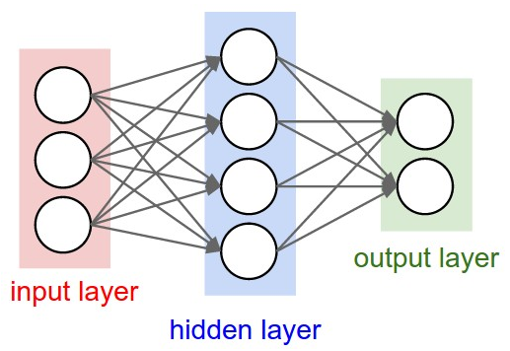
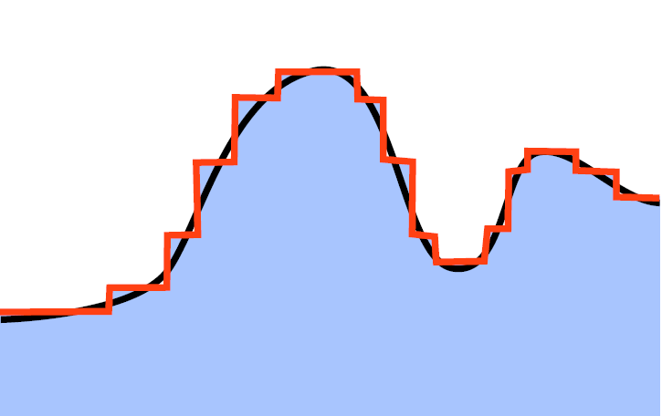
NN as a Universal Approximator
Universal approximation theorem:
Roughly speaking, with enough number of perceptrons in a hidden layer, one can approximate any continuous function f(x).
→Can be proved mathematically. (George Cybenko 1989 for sigmoid)
→Can be extended to multi-dimensional function
→Can be extended to any non-linear activation function
Meaning: One can use NN as a universal approximator of complicate non-linear function.
→ How one can actually make it for a specific problem?
Image from Ref.3

Slide 17
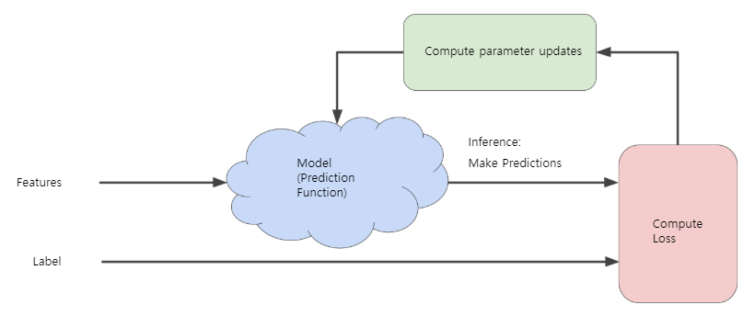
How to train NN (supervised learning)
Image from Ref.4
Loss/Cost/Risk : measure whether the algorithm is doing a good job
→ Mean squared error, cross-entropy …
Learning/Training: update parameters of model to reduce Loss.
→ Optimizer ( Gradient descent ,SGD, … )

Slide 18
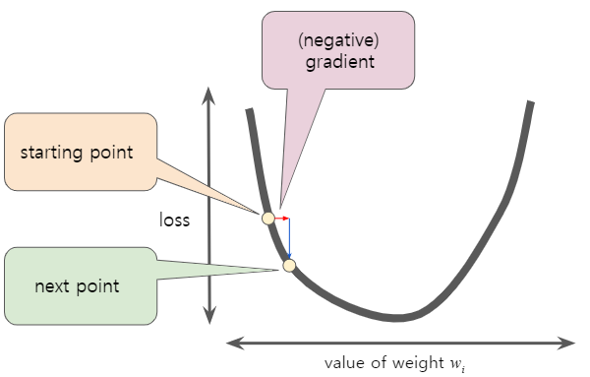
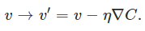
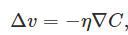
Gradient Descent
Optimizer : update parameters to reduce Loss.
Gradient descent : Change parameters
To the direction of
negative gradient of Loss function
Learning rate:
How much we change parameters
In each step.
Image from Ref.4

Slide 19
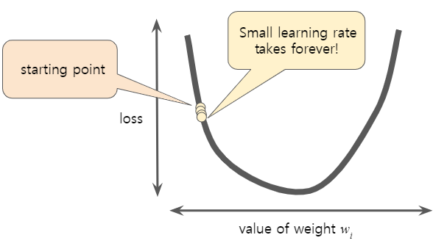
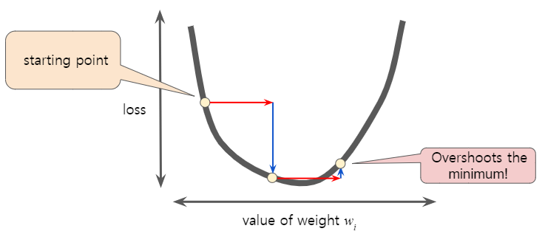
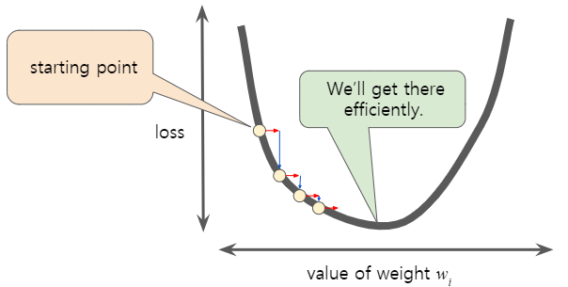
Gradient Descent
Epoch: using entire data to update parameter
→ In GD, one step=one epoch
Limitations of GD (Ref 5.)
GD finds local minima of the cost function
GD is Computationally expensive for large datasets
GD treats all directions in parameter space uniformly
GD is sensitive to initial conditions
GD can take a lot of time to escape from saddle points
Images from Ref.4

Slide 20
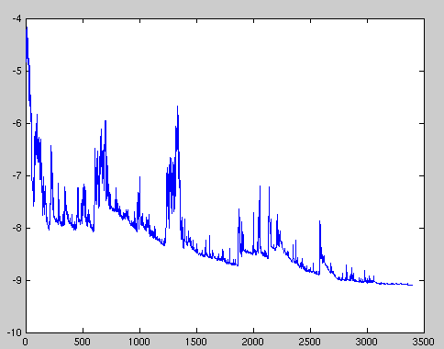
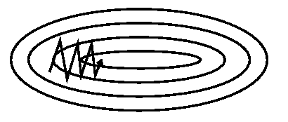
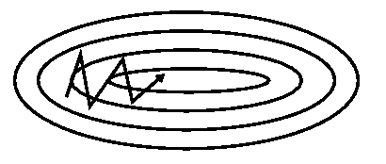
Optimizers
Stochastic Gradient Descent(SGD) :
Instead of using all dataset, one may use part of dataset to update parameters in one step
SGD is an extreme case of mini-batch size 1.
Usually very noisy. ( not all steps reduce Loss/Cost)
Mini-batch SGD: between full-batch and SGD. Can be more efficient than GD. Reduce amount of noise.
GD with momentum : “momentum” to remember the direction of previous learning
Adaptive methods: change learning rate adaptively
→ AdaGrad, RMSprop, AdaDelta, AdaM …..

Slide 21
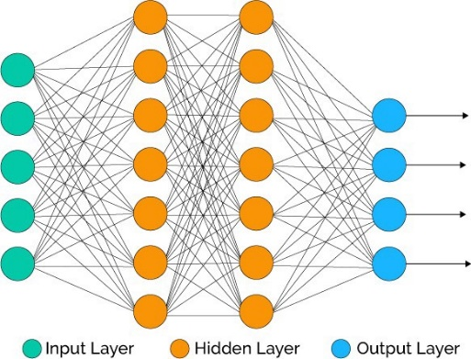
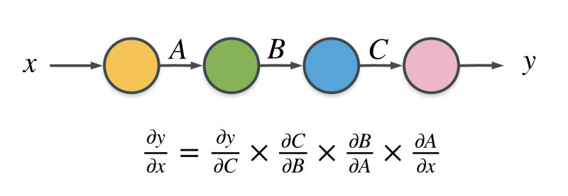
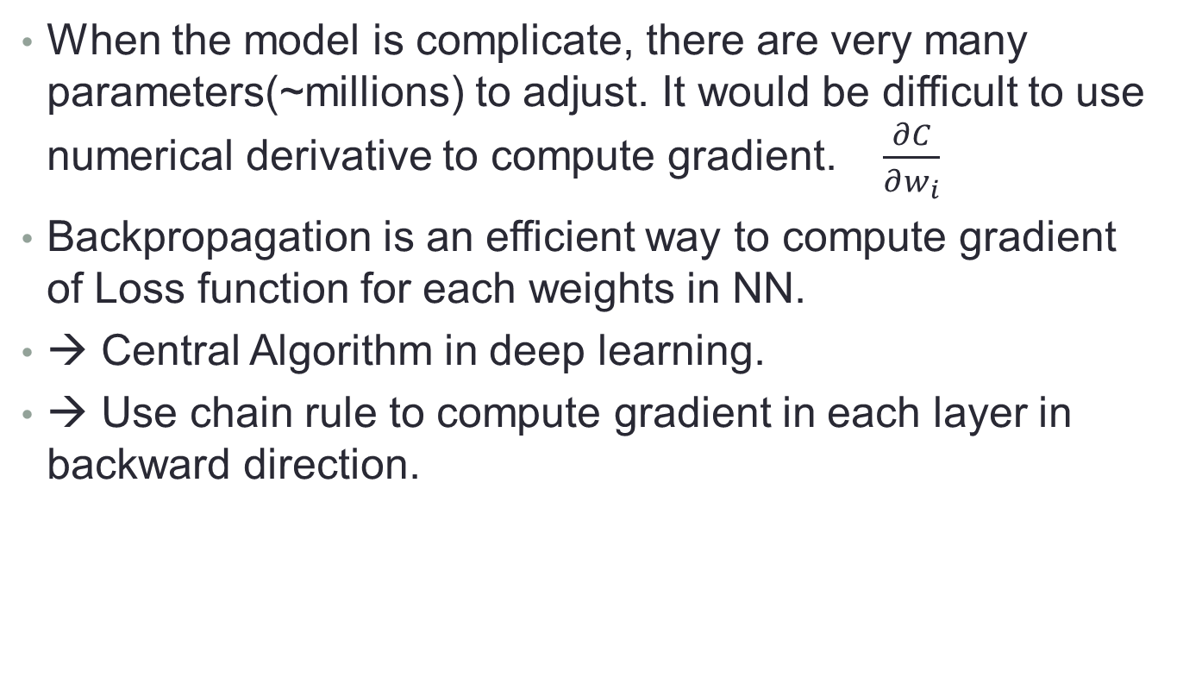
Backpropagation
When the model is complicate, there are very many parameters(~millions) to adjust. It would be difficult to use numerical derivative to compute gradient. $\frac{∂C}{∂w_{i}}$
Backpropagation is an efficient way to compute gradient of Loss function for each weights in NN.
→ Central Algorithm in deep learning.
→ Use chain rule to compute gradient in each layer in backward direction.
Image from https://www.freecodecamp.org

Slide 22
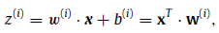
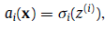
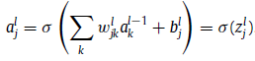
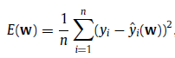
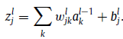
Backpropagation
Output of j-neuron in l-layer
Loss/Cost : MSE case

Slide 23

Overfitting
Fitting of data is not what we actually want.
We want to apply the model to unknown new data and make a reliable prediction. (generalization)
Model can work poorly when it is underfitted or overfitted.
Depends Model complexity , model’s performance on training data, number of data
→ Simple model can be better if same quality.
Image from blog in medium.com

Slide 24
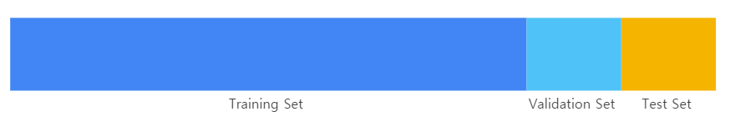
Data preparation
To prevent overfitting : need to monitor generalization
Training Set: data used to train the model
Validation Set: data not used for training model.
use results of validation set for tweaking.
Test Set: Data never used for training/tweaking model.
Always check data : quality of data should be even
Information leaking
Image from Ref.4

Slide 25
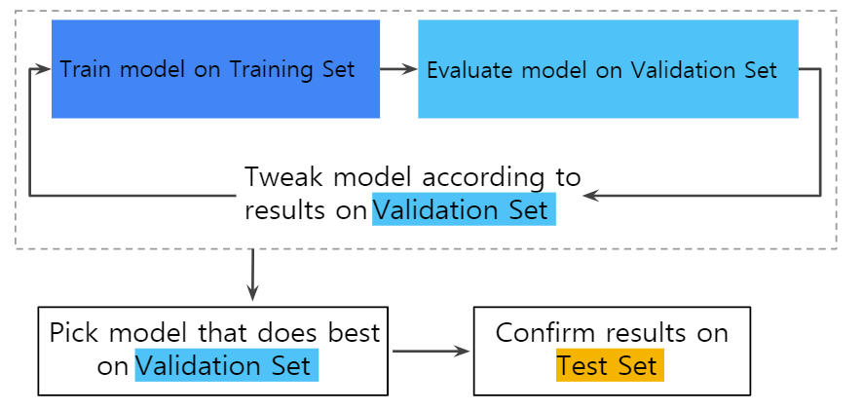
Image from Ref.4

Slide 26
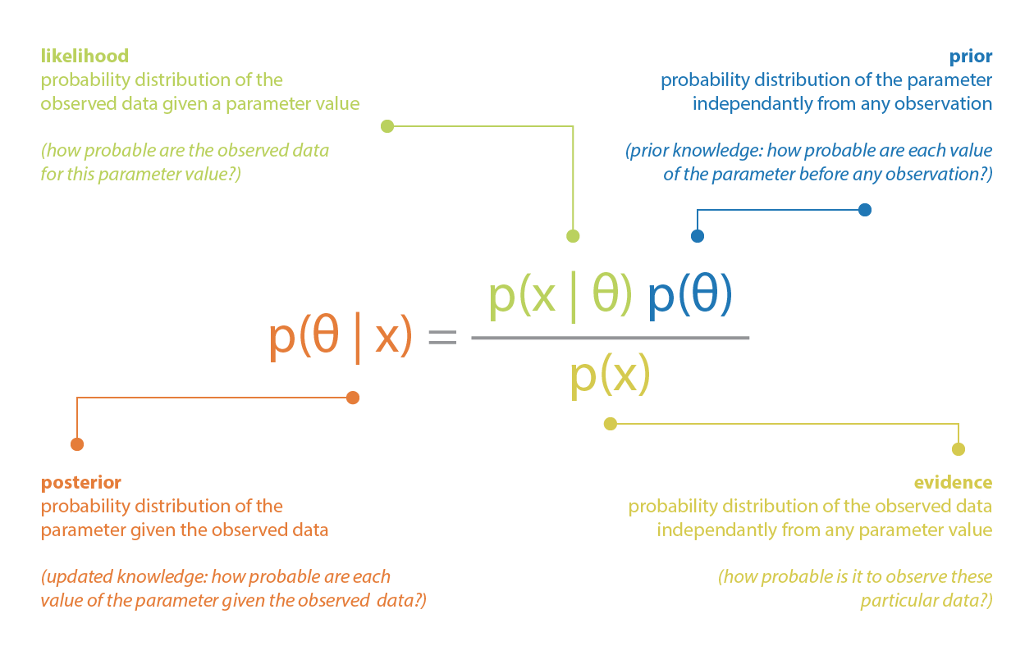
Bayesian NN
A way to make the NN to say “I don’t know”
The NN can give overly confident answers.
Introduce probabilistic inference (distributions, uncertainty)
Bayes theorem
X: event
Theta : Hypothesis
(we want to confirm)
Prior : Prior belief in hypothesis
Likelihood: probability x under theta
Evidence: probability x occur
Posterior: Post belief in hypothesis
after seeing event
From https://towardsdatascience.com/bayesian-inference-problem-mcmc-and-variational-inference-25a8aa9bce29

Slide 27
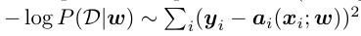
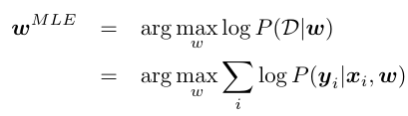
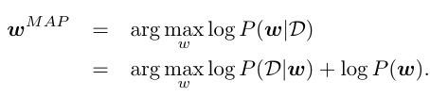
Bayesian NN
Usual NN is a Maximum Likelihood Estimation(MLE)
with Gaussian distribution
Maximum a Posteriori (MAP) weight corresponds to regularization with Gaussian prior
Bayesian inference gives a distribution, not one number
→ distribution gives uncertainty of prediction

Slide 28
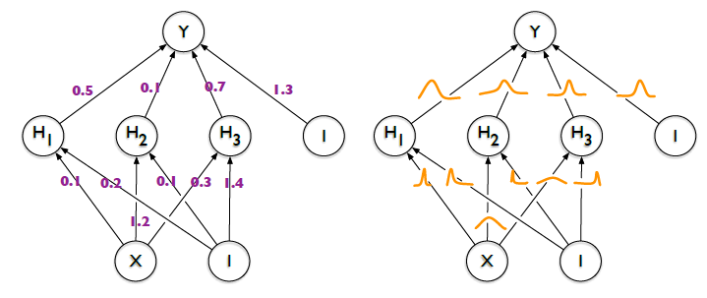
Bayesian NN
Variational inference is equivalent to change
Point weights w → Distribution of w ~ N( m, sigma)
Increase number of parameters twice.
Then, output of the network is also distribution.

Slide 29
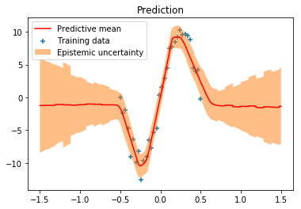
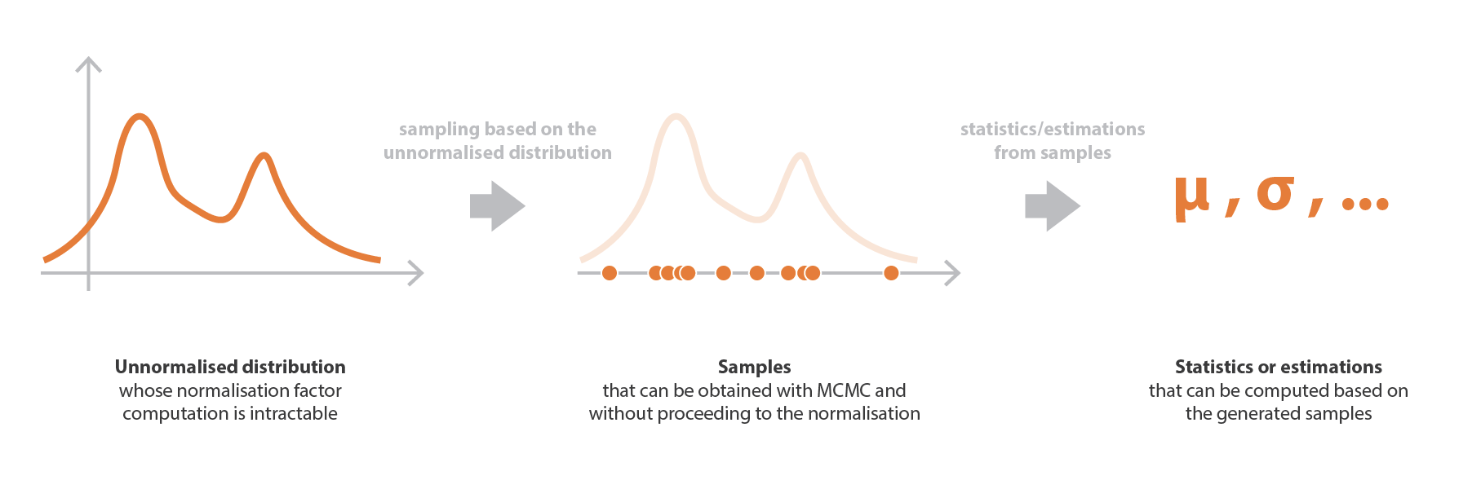

Bayesian NN
One may use
Markov Chain Monte Carlo(MCMC) : Generate samples according to distribution
Variational Inference(VI) : approximate posterior with family of known distribution
http://krasserm.github.io/2019/03/14/bayesian-neural-networks/

Slide 30



Gaussian Process
Non-parametric method : parameters are determined by the data.
Training is faster than non-parametric methods. (Only to remember data)
Inference can be slower.( Need to process all training data for prediction)
Example: Lagrange interpolation. Nadaraya-Watson kernel regression.

Slide 31



Gaussian Process
Gaussian process : defines prior over functions and
infer a distribution over functions.
Usually Inference is done by using parametrization of function
In GP modelling, use prior directly on the space of functions
without parametrization.
Prior over function is defined by joint Gaussian distribution with
mean function and covariance or kernel function

Slide 32




Gaussian Process
.
Kernel function describes
Correlation between function values
At two points.
smooth functions
Similar to Green’s function
Prior( Kernel function) determines the properties of GPs.

Slide 33




Gaussian Process
Joint distribution of observation and prediction
Posterior distribution is also Joint Gaussian distribution !!
One only have to find posterior mean and covariance
RBF kernel

Slide 34


Gaussian Process
Image from “Gaussian Processes for Machine Learning”, MIT press

Slide 35
Applications to Nuclear Physics
Various ML techniques applied to nuclear physics
In experiments, it can be used to control devices, classify data, triggering/detecting important event and so on…
Here let us look at several applications in theoretical nuclear physics.
This is not complete review of current status of application of ML in nuclear physics. Just some examples.

Slide 36
Applications of ML to interpolation/extrapolation of
(From arXiv:2006.05422v1 )
Nuclear masses
Charge Radii
Excited States
Beta Decay
Alpha Decay
Fission Yields
Nucleon-Nucleon Phase shifts
Neutron-alpha scattering and three-body parameters
Nuclear reaction cross sections
Estimates of truncation errors
Model calibration and reduction
Variational calculations

Slide 37




An Exercise : Mass Formula
Mass formula : BE/A(N,Z)
Atomic Mass Evaluation 2016
Only use experimentally measured values
N > 8
Z > 8
Randomize data
Train set and Test set
30% of train set is used for validation

Slide 38


An Exercise : Mass Formula
Model0 : Sequential Feed Forward NN
feature : (N,Z)
label : BE/A
Training: 300 Epochs

Slide 39




An Exercise : Mass Formula
True vs Predictions

Slide 40

An Exercise : Mass Formula
Model1 : Sequential Feed Forward NN
feature : normalized (N,Z) by mean and standard deviation of training data
label : BE/A
Training: 300 Epochs

Slide 41




An Exercise : Mass Formula

Slide 42


An Exercise : Mass Formula
Model2 : Sequential Feed Forward NN
feature : Binary coding of (N,Z)
label : BE/A
Training: 300 Epochs

Slide 43



An Exercise : Mass Formula

Slide 44


An Exercise : Mass Formula
Model3 : Sequential Feed Forward NN
feature : normalized (N,Z, N-Z)
label : BE/A
Training: 300 Epochs

Slide 45



An Exercise : Mass Formula

Slide 46




An Exercise : Extrapolation?
Model 0
Model 1
Model 2
Model 3

Slide 47
Plan
To make extrapolation→ validity/uncertainty quantification→ BNN
Working on : Application NN to alpha decay → Geiger-Nutall formula
Working on: Application of NN to reaction→ global optical potential generator

Slide 48



Nuclear Mass models
Statistical model study of nuclear mass

Slide 49





Slide 50



Hybrid Model:
Train NN with the difference
Between experiment
and theoretical model(FRDM)

Slide 51








Train mass residuals with BNN
→ Possible to estimate theoretical uncertainty

Slide 52


Theoretical Error estimation
Applied to NS
crust

Slide 53






Slide 54



Training of residual two-neutron separation energy
For BNN (one hidden layer 30 neurons) and GP.
Input data were smoothed with Gaussian folding to get general trends

Slide 55



Slide 56



Bayesian
Gaussian Process
Bayesian Model
Averaging

Slide 57



Extrapolation in
Model space of NCSM calculation
(Nmax,
Try to explore hyper-parameter space
To find best 50 models

Slide 58




Inputs:
Charge and Neutron number of Fission nuclei
Mass of fission fragment
Excitation energy of the compound nucleus
Output: Fission Yield

Slide 59






Gaussian Process
For truncation error of EFT
“c” are not LECs in theory

Slide 60





arXiv:1911.13092v1
Variational ANN

Slide 61



Train NN to learn EDF results
Fast emulator
model HFB calculation with five-dimensional collective Hamiltonian approach
Train 5DCH parameters with Committee of NN
Data Selection scheme to make HFB calculation

Slide 62



arXiv:2003.10770v1
Train NN to classify pole of amplitude
: training data constructed from pre-defined S-matrix structure
And tested with realistic NN potential scattering

